Slide 1


GROUP 1
CAPSTONE Final Presentation
PRESENTED BY:
damian d. | laila s. | sejiro k. | shane j.
“We’ll take the wheel on this one.”
STEERED.
FEB 16, 2026
Notes:
“We’ll take the wheel on this one.”

Slide 2






STEERED.
A way to remove the confusion and paralysis when choosing books, letting reading be the stress-free, relaxing activity that it should be.
Let us take the wheel on finding your next read, so you can get back in the pages.
Avoid a never-ending TBR list by finding books catered to your interests.
Lestat Hans
STEERED. PR
Notes:
Product Introduction
1-2 Minutes We will give you recommendations based on you. Input your preferences into our engine and it will give you personalized options for what you’re looking for. For now our engine has books, however in the future there will be more options to choose from. We want to be able to help alleviate the burden of choice from those who struggle to choose, to help streamline people's lives and let them enjoy whatever free time they have.

Slide 3
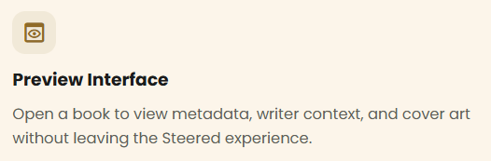
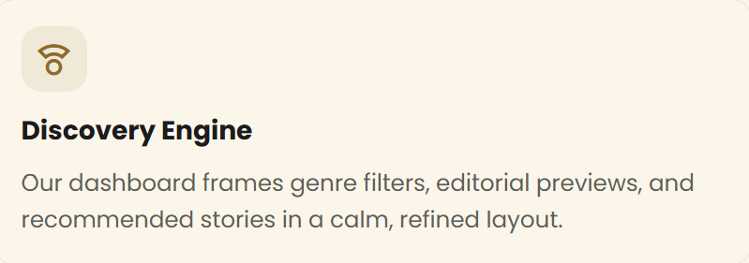
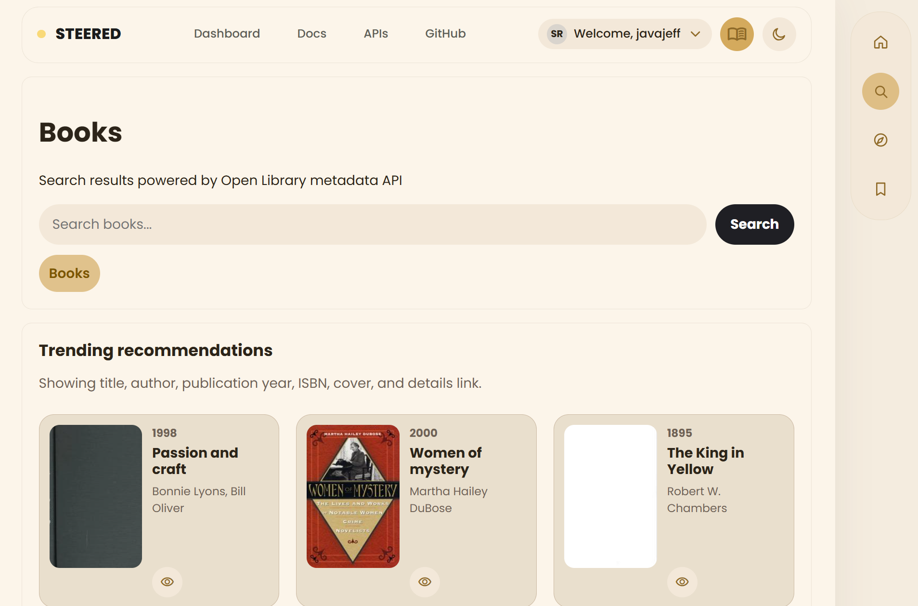


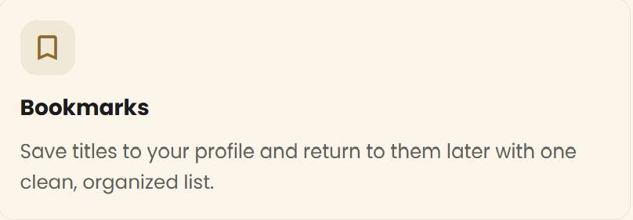
‘ HOW STEERED. WORKS ’
STEERED blends curated content with OpenLibrary metadata to create a calm, easy-to-navigate experience that simplifies decision-making.
70% of consumers struggle with indecision and confusion known as decision paralysis
Notes:
HOW IT WORKS (1-2 MINUTES)
SCRIPT
(AFTER READING THE SLIDE):
It’s designed to simplify the way people make decisions online. Instead of overwhelming users with endless options, this platform focuses on guiding them towards a smaller number of meaningful, relevant choices. Specifically when it comes to finding their next reading adventure. We designed STEERED based on three core principles: - 1. Minimal distraction - 2. Preferential context
- 3. And, open source code
To promote better focus, everything was made to be simple and clean, including the lack of ads, pop-ups, and busy UI. This was so that users could browse without feeling overwhelmed or bombarded with too many choices. In addition, we wanted STEERED to function past book titles and product names, so we enhanced results with custom notes, genres, and previews to help users actually understand their options. Lastly, by using OpenLibrary data, the platform stays transparent, accessible (free!), and grounded in real, public information.
So, with this foundation in mind, let’s take a look at how our features actually work…
We have our preview interface, which allows you to view a book’s metadata, author, and book cover without leaving the site.
Our discovery engine which is designed to display genre filters, book descriptions, and recommend stories in a calm and refined layout.
Users can use our bookmarks feature to save books to their profile for later reading. Our bookmarks tab puts titles into a clean, organized list.
Now we’re going to walk through how a user would actually use Steered in a real scenario.

Slide 4

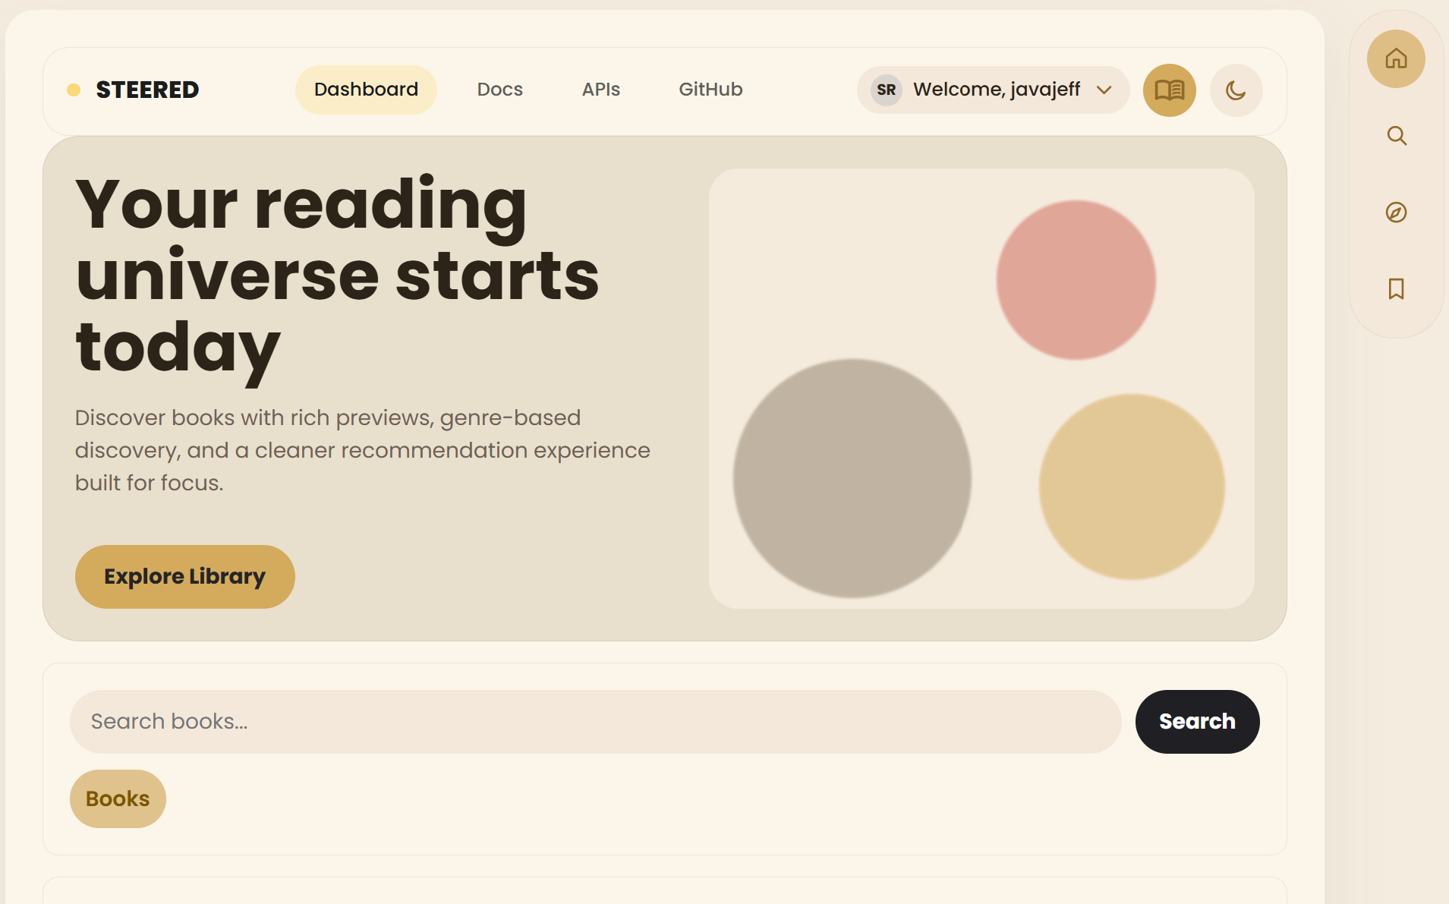





Find books tailored to your preferences,
discover your new favorite author, and build community with others through reviews.
Java Jeff
STEERED. User
SEARCH. FILTER. SAVE.
READING MADE SIMPLER.
Notes:
LANDING PAGE / HOMEPAGE
As soon as the user enters the platform, they’re given a clean, simple interface with a few clear basic genres– like fiction, sci-fi, and romance.
Instead of overwhelming them with options right away, we guide them to start with a focused search.
For this example, let’s say the user is looking for a new book…

Slide 5

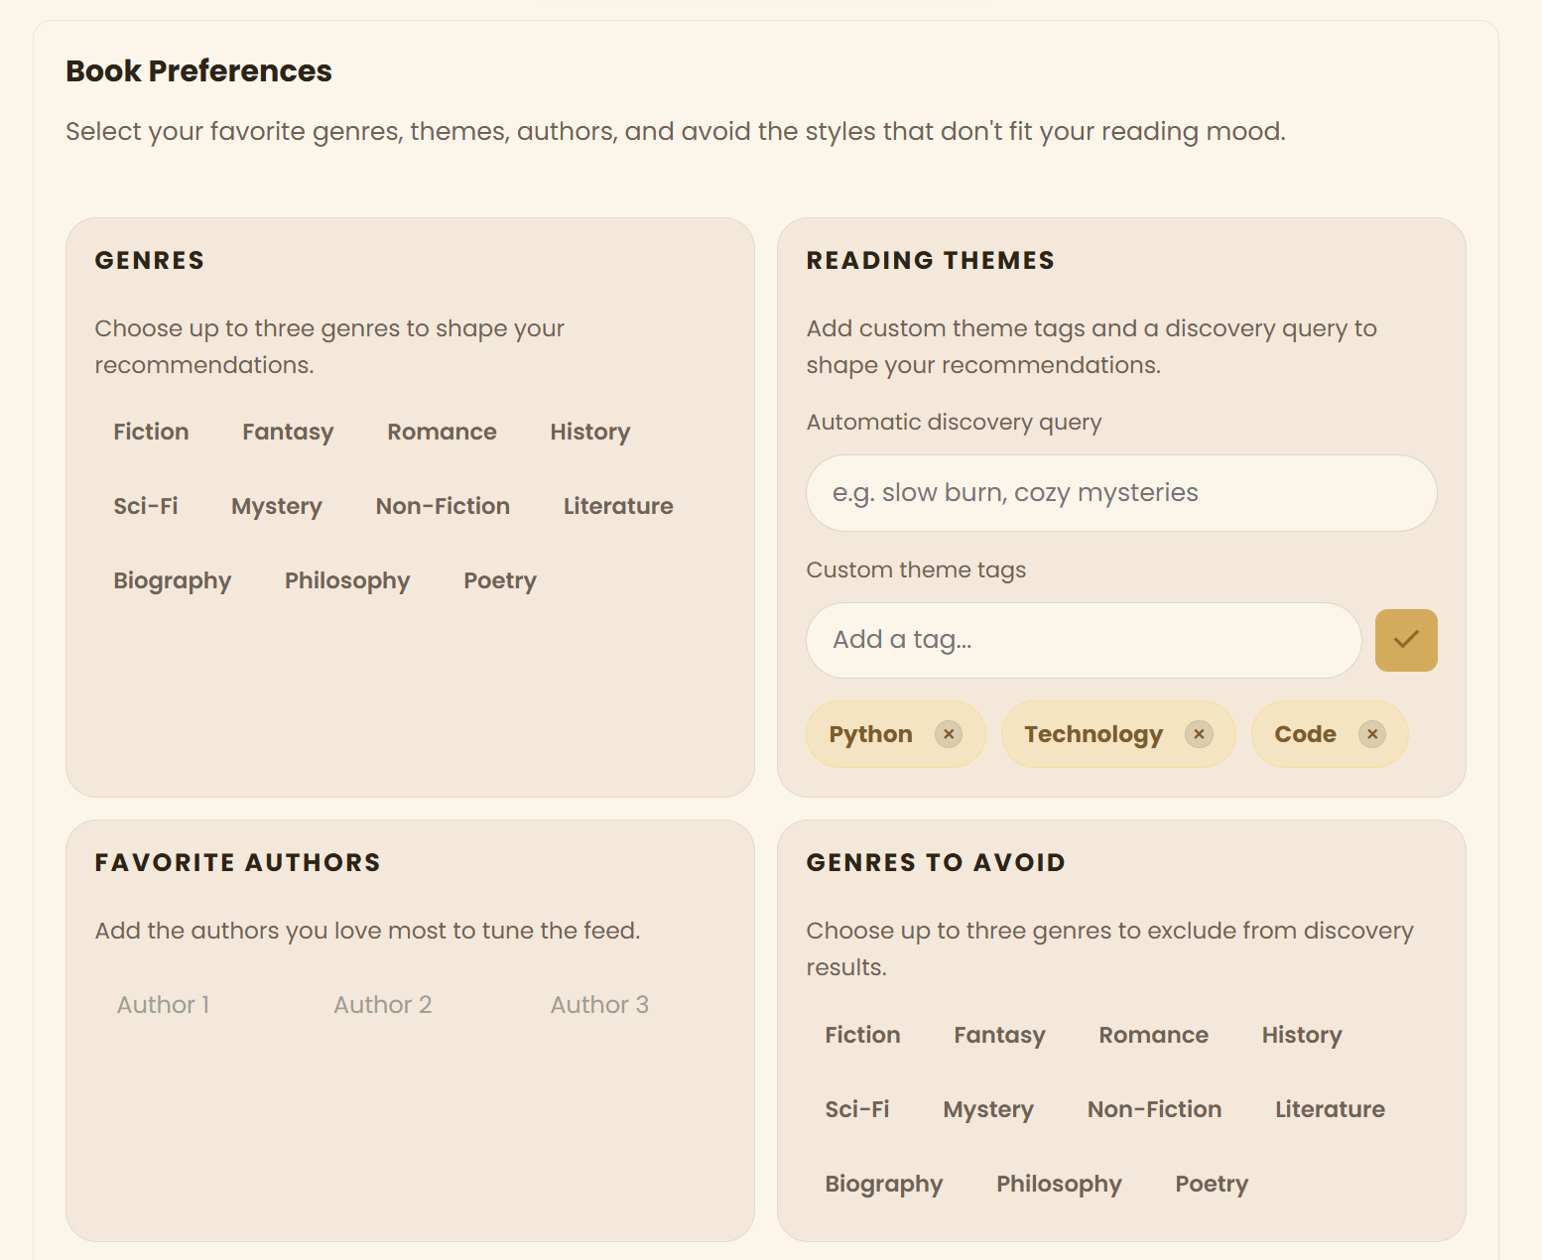
Filter by genre!
Find exactly what you’re looking for.
Notes:
Find exactly what you’re looking for:
Simply go to your account profile and select the things that interest you, or what doesn’t, and you’re on your way to finding your next favorite read.
Rather than scrolling through hundreds of results, guessing genres, or remembering author names, the user can also search by simply using a theme (like ‘cozy’ or ‘mystery’).
This is where Steered helps reduce decision overload, by narrowing results to something more intentional for it users. Searching an endless library can be daunting, but with Steered you can pick filters to find what genres you want, authors you like, and even ignore the genres you aren’t looking for. Our engine does all of the work for you, not only saving you time but getting rid of that overwhelming feeling that comes with looking through nearly endless options. And to make sure everything is secure, we included session-based authentication, so user data like saved books and preferences can be preserved. Over time, the platform becomes more personalized so that users can set preferences made beforehand like favorite reading themes and categories to avoids, directly influencing future recommendations.

Slide 6

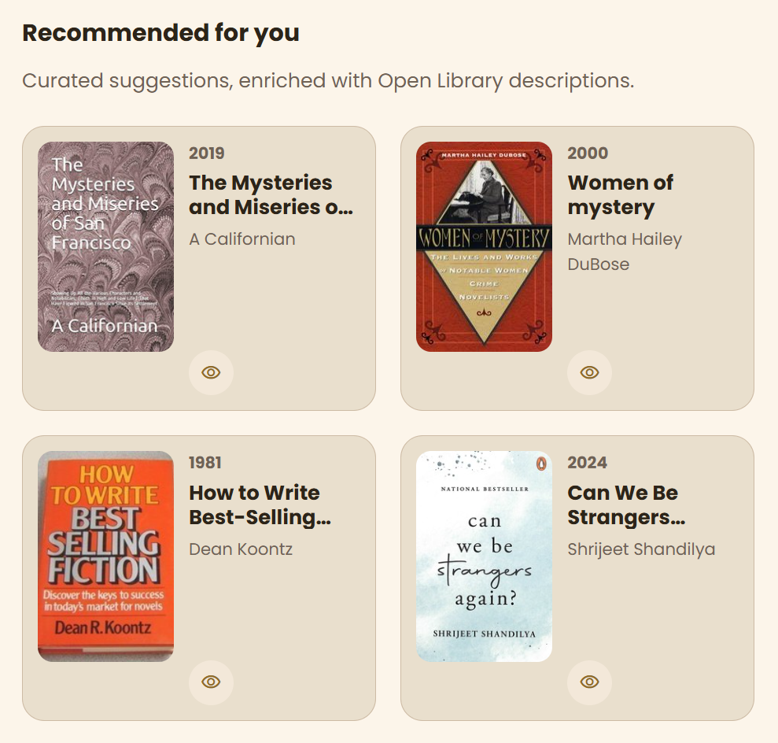
See what’s recommended!
Discover new authors and trending reads based on your interests.
Notes:
See what’s trending:
Now, instead of a long, overwhelming list, the user gets a smaller set of curated options from their Discovery page. Each result includes not just metadata, but also helpful context like summaries, genres, or notes. This can quickly understand what each option offers.
If something stands out, the user can save it for later to avoid losing good options and keeps their decision process organized.

Slide 7

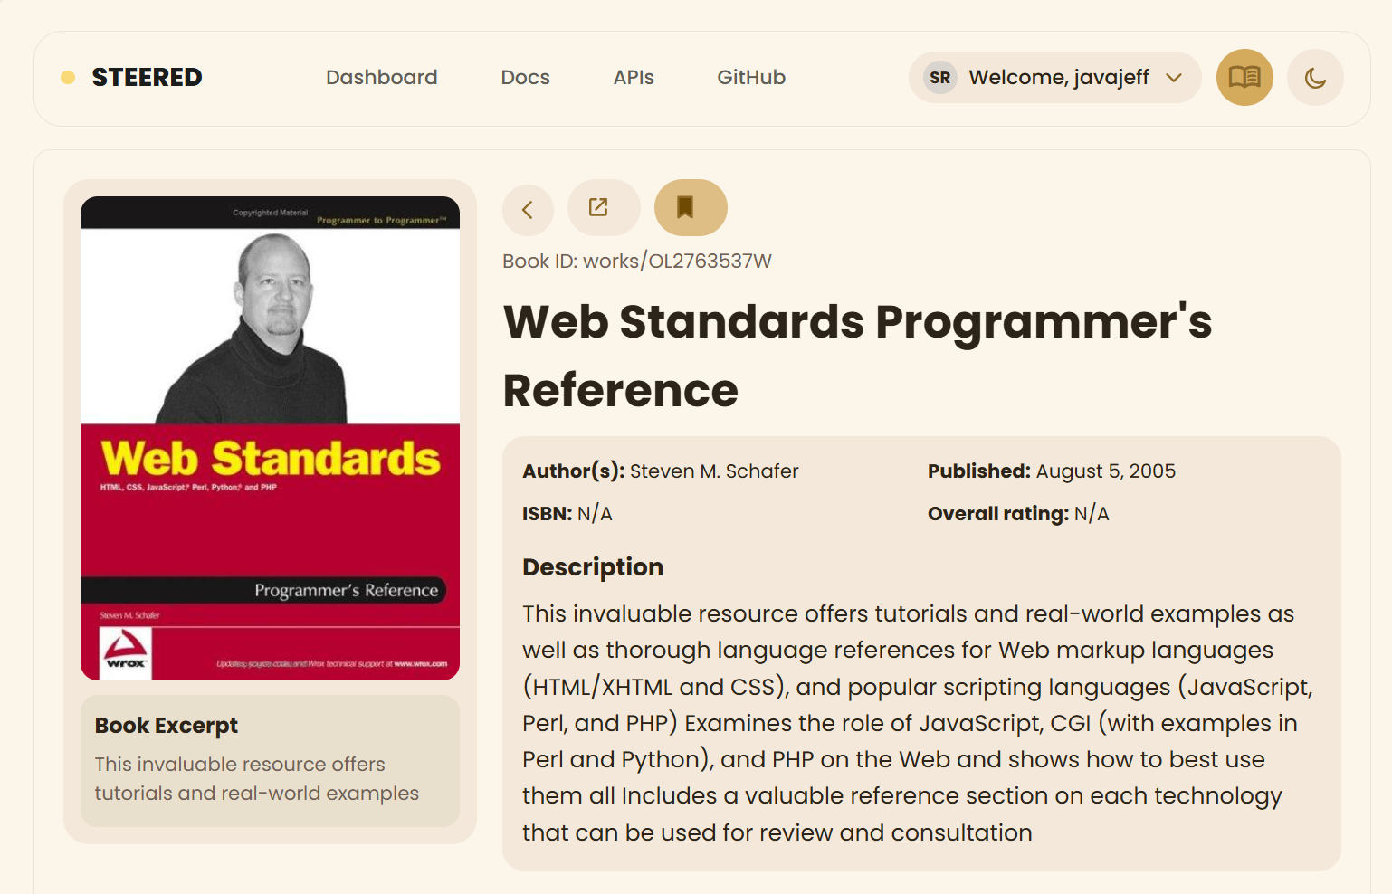
Save your finds for easy access when you’re ready for your next book.
Save your finds!
Notes:
Save your finds:
Like what you see? Save it to your bookmarks to find it later. This is important because one of the biggest problems with decision-making online is losing track of good options. Instead of reopening tabs or starting over, everything is stored in one place.
All of your books will be in one place allowing you to curate a list of titles that you can enjoy. Once you finish a book you can give it a rating or leave a comment so that other Steered users can know what you think of it, creating a great community of readers who want to find their next favorite book, or know what to avoid.

Slide 8

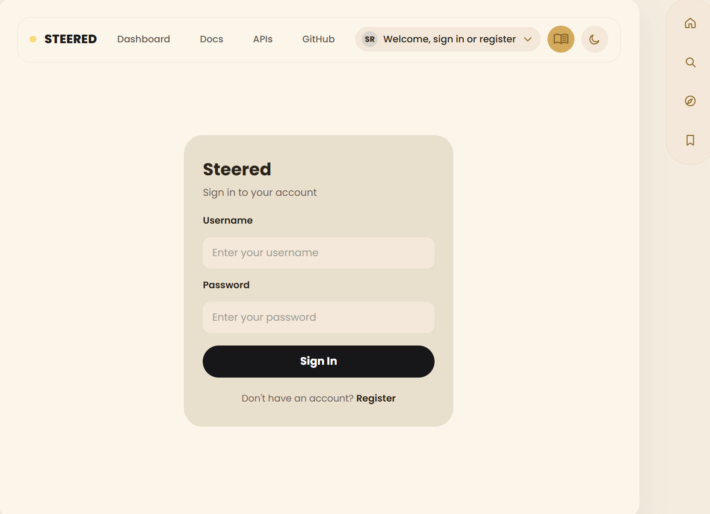
Create your profile
Fast sign up process lets you keep track of everything in the app.
Notes:
Create your account:
To unlock this kind of personalization, users can creat a profile using our quick and easy sign up process that allows you to set your preferences for a more personalized experience.
After creating your account you will be able to save anything you’ve found, and the recommendations will be tailored to your interests. So while STEERED works just fine without an account, creating a profile makes the experience more effective as everything will be stored in our databases so you can keep track of what you’ve been doing across the app.

Slide 9
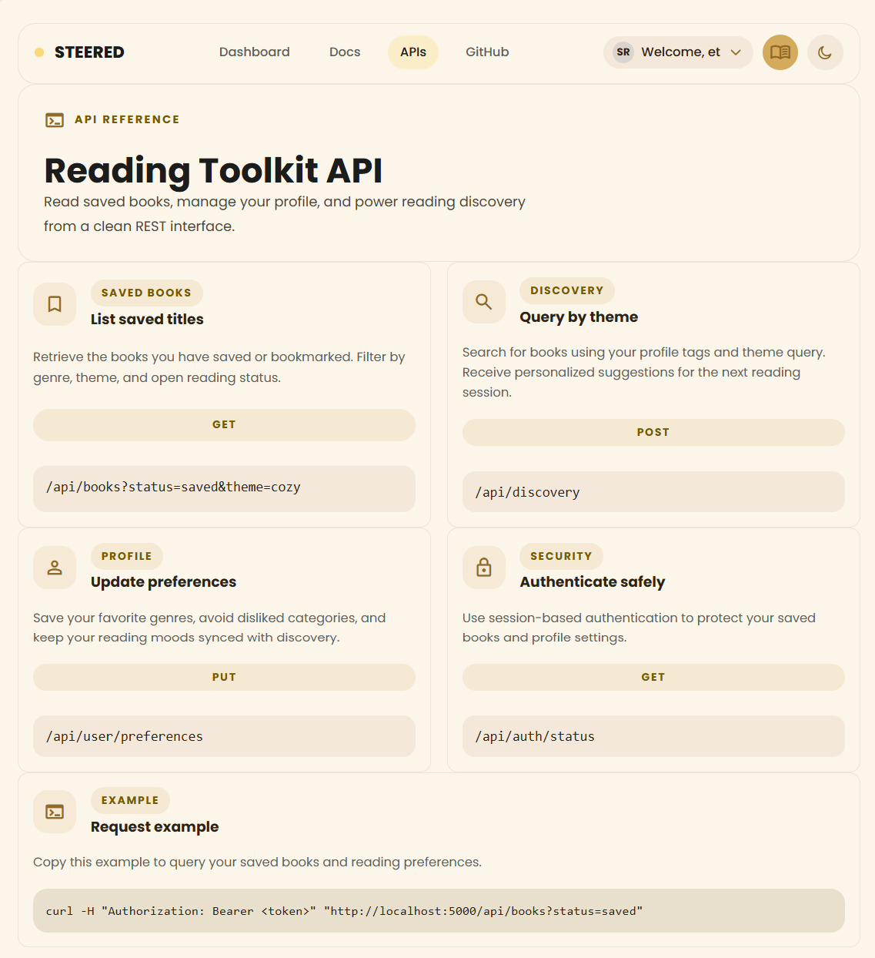
‘ READING TOOLKIT API ’
STEERED’s reading toolkit API allows you to customize your experience by managing saved books, preferences and discover in a simple and scalable way?
An easy-to-use system that moves with you.
Notes:
TOOLKIT API (1-2 MINUTES)
SCRIPT
(AFTER READING THE SLIDE):
What makes Steered more than just a clean interface is what’s happening behind the scenes. We’ve developed a backend system called the Reading Toolkit API, which powers how STEERED processes data, personalization and user interactions. This API is built around a clean REST structure, meaning our app talks to a server using URLs + HTTP methods to get or send data to communicate over the web.
Every search, filter, and saved item is powered by a structured system that connects the user experience to real data.
That system is our API.

Slide 10
GROUP 1
QUESTIONS ARE WELCOME
“We’ll take the wheel on this one.”
STEERED.
PRESENTED BY:
damian d. | laila s. | sejiro k. | shane j.
FEB 16, 2026 - MAY 3, 2026
Notes:
CLOSING STATEMENT
We started with a simple problem: too many choices can make decision-making harder, not easier.
With that we deisgned Steered, a platform that doesn’t just give users more options, but helps guide them toward the right ones through structure, context, and personalization.
From the interface to the API, every part of the system works together to reduce overwhelm and support better decisions.
And ultimately, that’s what Steered is about— “Just let us take the wheel on this one.”

